Slide 1


Notes:
Hi – my name is [insert name here] and I will be doing a presentation developed by the National Institute on Deafness and Other Communication Disorders, or NIDCD. The NIDCD is part of the National Institutes of Health, or NIH. Has anyone heard of the NIH?
Wait for answers.
The NIH is a federal agency that funds and conducts biomedical research. There are 27 Institutes and Centers within the NIH. Each one focuses on a different body part or disease type. At the NIDCD, one of the topics that they study is hearing loss.
Ask: “What age do you think hearing loss happens?” and call on kids for answers.
When you hear the words “hearing loss” most people think of older people and that certainly can be the case. People do tend to lose their hearing as they age. But hearing loss can affect anyone, no matter what their age is.
Ask: “Would you agree that it’s a noisy planet?”
Ask: “What are some examples of noisy activities and noisy places?”
Just like you mentioned, some examples of noisy activities include:
Concerts
Traffic
Fireworks
Listening to loud music through headphones
Movie theaters
Today we’ll talk about noise (point to “Noisy” on slide) and hearing loss (point to “Hearing” on slide), and what we can do to protect our hearing against damage caused by noise, which is called noise-induced hearing loss (point to the word “Protect” on slide).
Ask: “Can you tell me what we can do to protect our hearing from noise-induced hearing loss?”
Review three activities: lower the volume, move away from the noise, and wear hearing protectors, such as earplugs and earmuffs.

Slide 2
What Is Sound?
Sound is energy, like light or electricity.
Sound is made when objects vibrate.
Sound vibrations travel in waves by pushing
air molecules together.
Vibrations can be powerful. The stronger the vibrations,
the louder the sound.
Sound is measured in decibels.
Notes:
[Noisy Planet Student Activity: Refer to the Tuning Fork Demonstration video as a guide (https://www.noisyplanet.nidcd.nih.gov/educators/teacher-toolkit).]
Before we can understand how noises can affect our hearing, we need to understand sound. What is sound?
Wait for them to suggest answers. Then, one by one, click on the “enter” key to bring up each bullet.
1) Sound is energy, like light or electricity.
Use the crank flashlight to show how energy is needed to turn it on.
This demonstration shows how energy cannot be created or destroyed but transformed from one type into another—from mechanical energy (turning the crank) into electrical energy.
2) Sound is caused by pushing air molecules together.
Try clapping your hands. The force of your hands coming together causes molecules in the air to be pushed together. That compression travels through the air in all directions, and will soon reach your ears.
3) Sound is often made by vibrations in the air.
Some sounds are caused by vibrations, which are rhythmic compressions of air. We call these sound waves.
Ask: “What are some examples of things that vibrate to cause sound?” (a bell, guitar string, blowing on a blade of grass, your vocal cords/folds when you speak)
4) Vibrations can be powerful. The stronger the vibrations, the louder the sound.
Demonstrate how vibrations from a tuning fork affect a ping-pong ball. (Hold the ping-pong ball against a tuning fork. The tuning fork isn’t vibrating, so the ping-pong will be still. Then, strike the tuning fork hard on the bottom of your shoe or on the ground or table. When the tuning fork is vibrating, it makes a sound, and the ping-pong ball will bounce against it.).
Demonstrate how a plastic cup telephone works. (When you speak into the cup, it causes the bottom of the cup to vibrate. This vibration causes the fishing wire connecting the two cups to vibrate, which vibrates the bottom of the second cup, and that enables you to hear the person’s voice).
5) Sound is measured in decibels.
What other things do you measure?
Give examples of units of measure for height, weight, or temperature (inches, pounds, degrees, etc.).
The decibel range that we can hear is roughly 0 decibels to over 100 decibels. The softer the sound, the lower the sound pressure, and the lower the decibel level; the louder the sound, the higher the sound pressure, and the higher the decibel level. The softest sound is 0 decibels, which is like the sound of a pin drop. A whisper is around 30 decibels. Normal conversation is around 60 decibels. Prolonged exposure to any noise at or above 85 decibels can cause gradual hearing loss. The louder the sound, the shorter the period of exposure before hearing loss results.

Slide 3
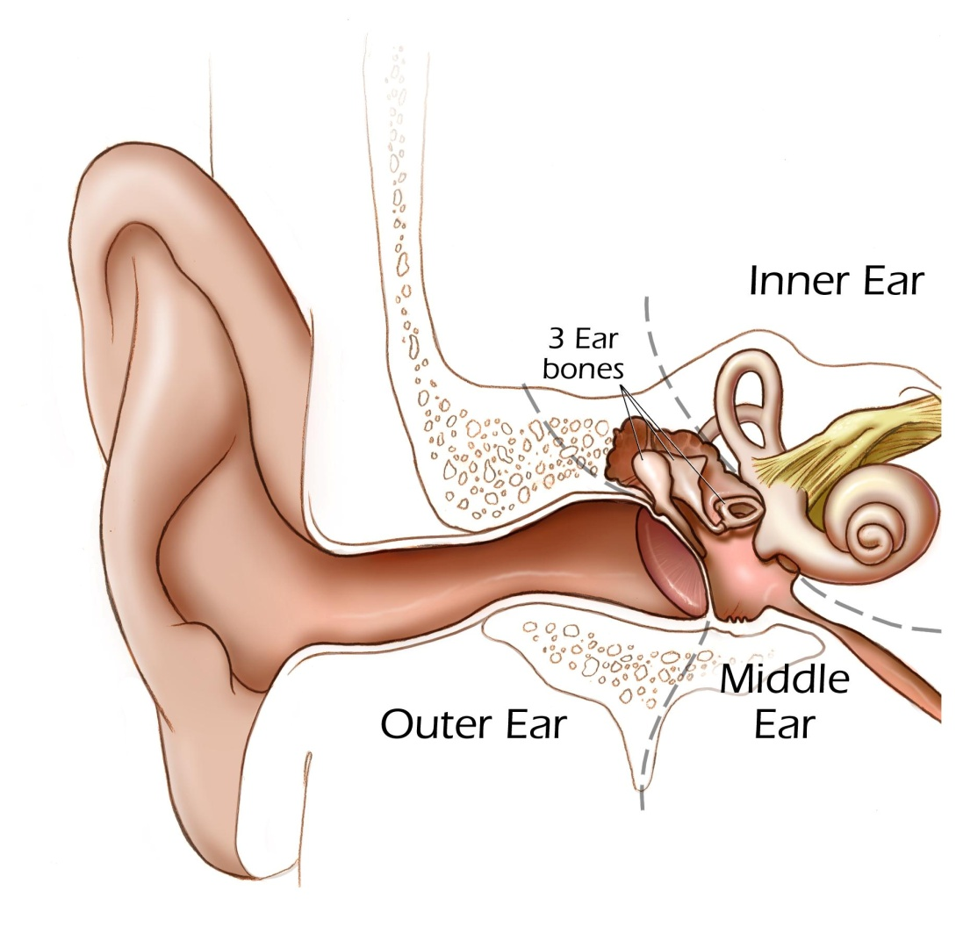
How Do We Hear?
Cochlea
Eardrum
Notes:
[Noisy Planet Student Activity: Refer to the How We Hear Demonstration video as a guide. (https://www.noisyplanet.nidcd.nih.gov/educators/teacher-toolkit)]
Our ear is an amazing instrument for capturing sound vibrations. Take a trumpet, for instance. When it's played, it makes sound waves in the air. The outer ear catches the waves, which then travel through a narrow passageway called the ear canal.
The sound waves reach the eardrum. The sound waves make the eardrum vibrate, which in turn vibrates three tiny bones called the malleus, incus, and stapes. These are the smallest bones in your body and together they are smaller than an orange seed. These bones amplify, or increase, the sound vibrations and send them to the cochlea, the part of the inner ear that is shaped like a snail.
The cochlea is filled with fluid, and the vibrations make waves in the fluid. Sensory hearing cells get activated as the wave reaches the part of the cochlea that they are sitting in.
Have 7 students act out the process: Kids should line up in a straight line, side-by-side, facing the classroom. The first kid acts as the noise source (bike horn). The second kid acts as the eardrum (he/she is holding a round vinyl disk); the next three kids act as the malleus, the incus, and the stapes. The fifth kid acts as the cochlea and stands to the right of the child acting as the stapes. The last kid is the brain (flashlight). When the first kid honks the horn, the second kid bangs the “eardrum,” the next three kids representing the three bones start vibrating/wiggling/dancing, the kid acting as the cochlea starts sloshing, and the last kid turns on the flashlight to show the electrical signal has reached the brain.

Slide 4
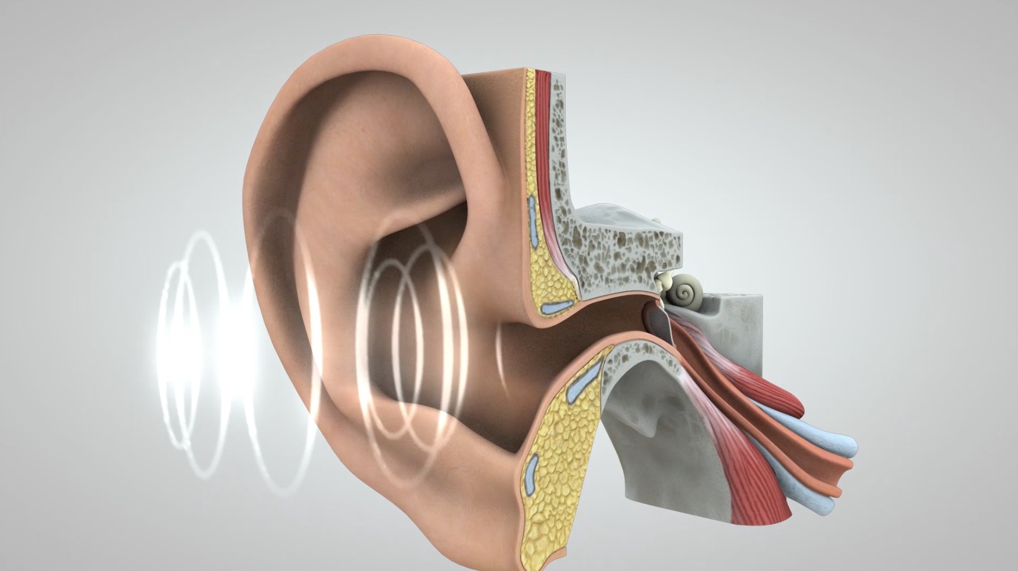
Journey of Sound to the Brain
https://www.youtube.com/watch?v=inAHoYuTS7U
Notes:
Watch this video to see an animation of the journey of sound to the brain.
Show the video “Journey of Sound to the Brain”(https://www.youtube.com/watch?v=inAHoYuTS7U)

Slide 5
How does sound damage our hearing?
Notes:
Ask: “How do you think sound damages our hearing?”

Slide 6
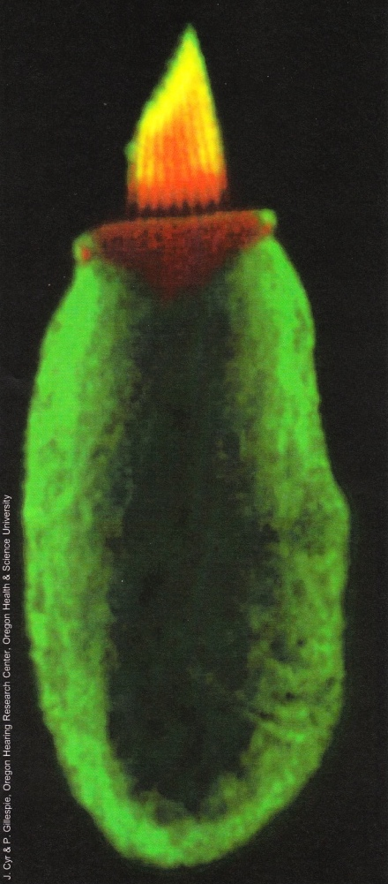
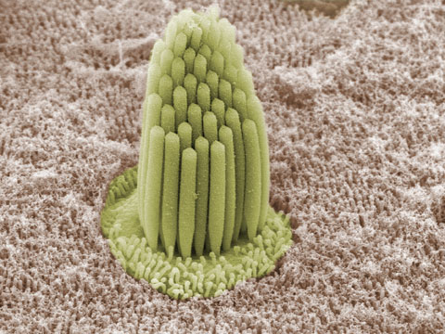
Healthy Stereocilia
Notes:
[Noisy Planet Student Activity: Refer to the Hair Cell Demonstration video as a guide. (https://www.noisyplanet.nidcd.nih.gov/educators/teacher-toolkit)]
Remember those sensory cells I was talking about in the last slide? Well, this is what they look like. They are called hair cells. No, not like the ones on your head! Instead, each hair cell is topped with a set of precisely arranged structures called stereocilia. This arrangement of stereocilia is sometimes called a hair cell bundle.
Have you ever seen someone with a crewcut or a mohawk? (Or have you ever had bed head so bad that your hair stands straight up on top of your head?) The tops of hair cells look kind of like that. These stereocilia are very important in the hearing process. They bend when sound vibrations reach your ears. The softer the sound (clap softly), the less they bend. The louder the sound (clap loudly), the more they bend.
There are 18,000 hair cells in each ear. These hair cells are so small, all 18,000 of them can sit on the head of a pin.
We’re going to make a model of a hair cell. Have you ever made a model before? In this model, your hand is the body of a single hair cell, and the pipe cleaners represent stereocilia. What’s your arm? (The hearing, or auditory, nerve.)
Pass out 5 pipe cleaners to each kid. Have them hold the pipe cleaners in their fist while you tell the story of a typical 4th of July day.
You get up, and you make a bowl of cereal, which is now snapping, crackling, and popping (students run their hands over pipe cleaners a little).
Then you are asked to go outside and mow the lawn. You go out (without hearing protection) and start the mower, which is loud (students run their hands over pipe cleaners more).
Then you go to a picnic and you’re having a great time. At 10 p.m., it’s time for the fireworks, and you go down to the front row, and all of the sudden, you hear BOOM BANG BOOM! (Students are running their hands over their pipe cleaners like crazy).
Now let’s look at our stereocilia. (Most are going to look very misshapen and bent.) Can you fix them? No, you can’t seem to fix them, can you?
So now that we know what sound is and how we hear sounds, how do you think sound damages our hearing?
Ask students for examples.

Slide 7
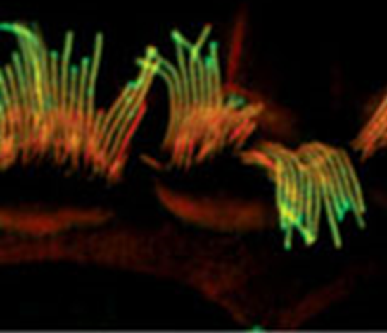
What Too Much Noise
Can Do to Stereocilia
Picture of damaged stereocilia
Notes:
Just like the damaged pipe cleaners, stereocilia can be damaged after too much noise. And just like the fact that you can’t make the pipe cleaners go back to normal, you can’t fix stereocilia. Furthermore, when stereocilia are damaged, the hair cells do not continue to function normally. Only fish, frogs, and birds can regrow new hair cells after they have been damaged. Scientists are trying to figure out how to get hair cells to regrow in people, but that hasn’t happened yet.
Have you ever been to a concert and heard ringing in your ears? That’s called tinnitus. For some people, tinnitus lasts a short while, but for other people who have been around loud noise for a long time, tinnitus can be permanent. There is no cure for tinnitus. Tinnitus is your body’s way of saying that you have been exposed to noise that is much too loud.

Slide 8
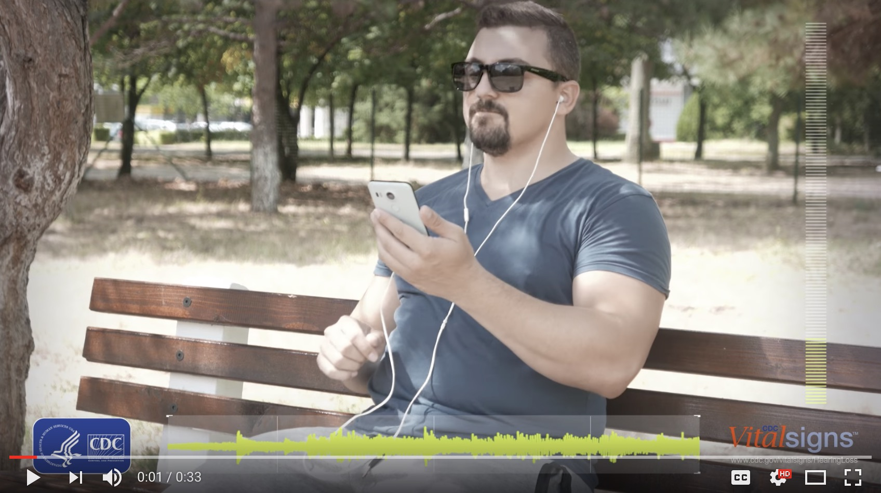
Keep the Volume Down…
https://youtu.be/krqGja-pDcc
Notes:
Watch this video to see how listening to loud sounds for too long can damage your hearing.
Show the CDC video “Keep the volume down – Too loud and too long can damage your hearing.” (https://www.youtube.com/watch?v=krqGja-pDcc)

Slide 9
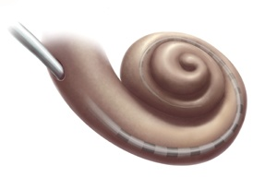
The Cochlea
Hair cells on this end detect low-pitched sounds (like a bass guitar and men’s voices).
Hair cells on this end detect high-pitched sounds (like cell phones and young children’s voices).
Notes:
Another interesting thing about hair cells is that they detect sounds of different frequency because of where they are in the cochlea. Sounds at the entrance detect high-pitched sounds, while sounds at the far end detect low-pitched sounds, with a range of sounds from high- to low-frequency in between, like a piano.
As we age, hair cells at the entrance to the cochlea wear out before those at the opposite end. Scientists aren’t entirely sure why. Some feel that hair cells that detect high-pitched sounds may be more vulnerable to injury. Others feel that hair cells at the opening of the cochlea may be exposed to more sound vibrations due to their location, so they are likely to wear out faster. The result is that we are less and less able to hear high-pitched sounds as we get older.

Slide 10

A sound most adults can’t hear
Notes:
I’m going to play a sound and raise your hand if you can hear it.
Select the speaker icon to play sound tone. (Most students will raise their hands, while most adults in the room won’t.)
Some businesses have taken advantage of this phenomenon. They will produce ringtones for cell phones that only children will hear, or they’ll produce sounds for businesses to play in their parking lots to discourage loitering.

Slide 11

What’s That Sound?
Guess what common noises sound like if you have hearing loss.
http://www.dangerousdecibels.org/virtualexhibit/1whatsthatsound.html
Notes:
Have you ever wondered what it’s like to have hearing loss? Some sounds aren’t going to be as crisp and clear sounding. In this activity, we’re going to listen to what some common sounds sound like to someone with hearing loss. See if you can guess what they are.
Mention that this is from the Dangerous Decibels website, which is a partner of the Noisy Planet campaign.
Walk through this activity by asking kids to guess what each sound is. (http://www.dangerousdecibels.org/virtualexhibit/1whatsthatsound.html)

Slide 12
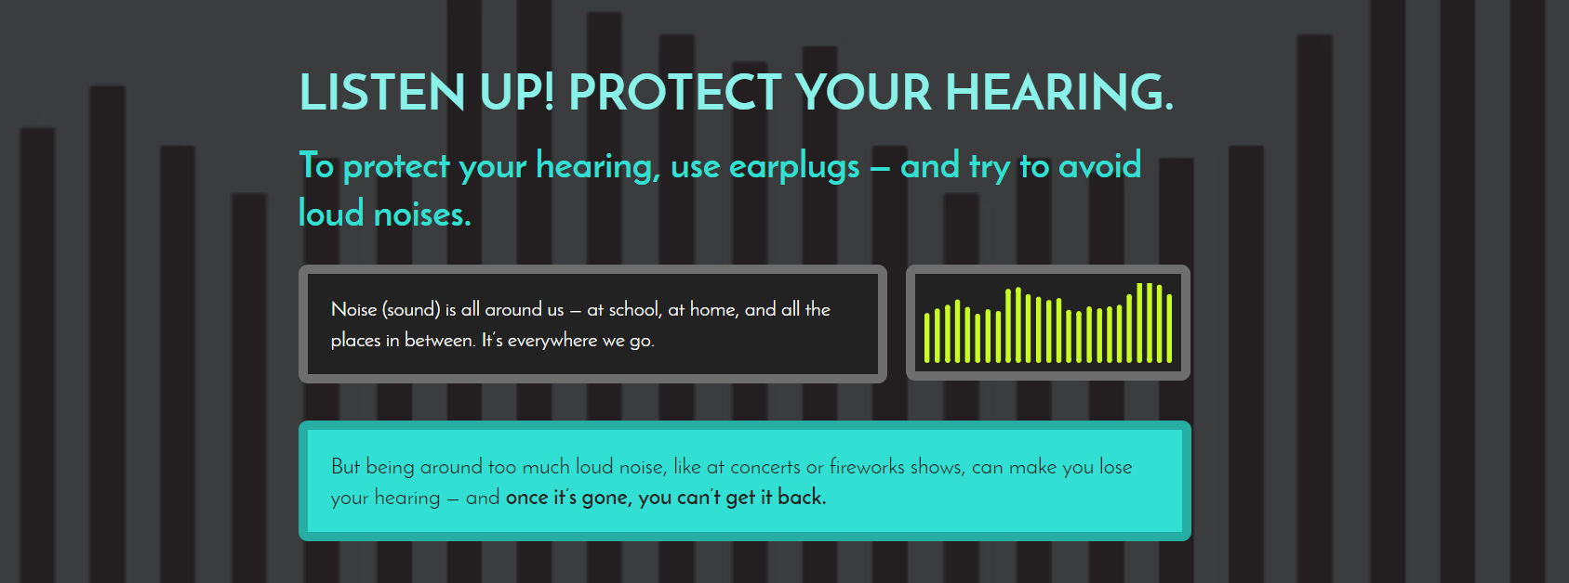
How Loud Is Too Loud?
https://www.noisyplanet.nidcd.nih.gov/kids-preteens/listen-up-infographic
Notes:
Show examples of sounds that are too loud in the Listen Up! Protect Your Hearing infographic. (https://www.noisyplanet.nidcd.nih.gov/kids-preteens/listen-up-infographic)

Slide 13
What can you do to protect your hearing?
Notes:
As I mentioned at the very beginning, there are three things we can do to protect our hearing from loud sounds. What are they?
Call on kids to answer the three ways to protect their hearing: lower the volume, move away from the noise, or wear hearing protectors.
The next 3 slides reveal the three ways to protect their hearing.

Slide 14


Slide 15


Slide 16

Notes:
Show the types of hearing protectors.
Expandable foam earplugs are formable earplugs that are created to expand and mold to the shape of each user’s ear canal.
Demonstrate how to put in and remove earplugs: Roll the earplug into a thin, crease-free cylinder. The tube must be thin enough so that half of the length will fit easily into the ear canal. Slide tube halfway into ear canal and leave to expand until there is a tight seal.
Canal caps often look like ear plugs on a flexible plastic or metal band with either a moldable or premolded tip. These may be either connected by a band to place over the head or jointed bands.
Demonstrate how to put in and remove canal caps: Place the band in its respective location and slide the earplug halfway into your ear canal (form them beforehand if they are the moldable type).
Earmuffs are plastic cups that cover the outer ear that protection from outside noise. They fit most users and come with different size cups.
Demonstrate how to put on earmuffs: Grab each cup of the ear muffs, one in each hand, and pull apart to stretch. Place the band over the top of your head and slowly release the cups so their placement covers the outer ear.
High-fidelity earplugs are made from hardened silicone, plastic, or rubber, and come in either a variety of sizes, or “one-size-fits-most.” Custom high-fidelity earplugs are custom made for each user’s ear. They are made by making an impression of the ear canal, and then the molds are formed. These earplugs don't change sound quality except for making it softer, which can be useful when it’s important to hear speech.
Demonstrate how to put on high-fidelity earplugs: Reach over your head with one hand to pull up on your ear. Then use your other hand to insert the plug with a gentle rocking motion until you have sealed the ear canal. Custom ear plugs should fit easier without having to do the rocking motion for insertion.

Slide 17

Notes:
Michael Phelps’ son wore earmuff hearing protectors to safely watch his dad win gold medals in a noisy pool stadium during the 2016 Olympics.

Slide 18
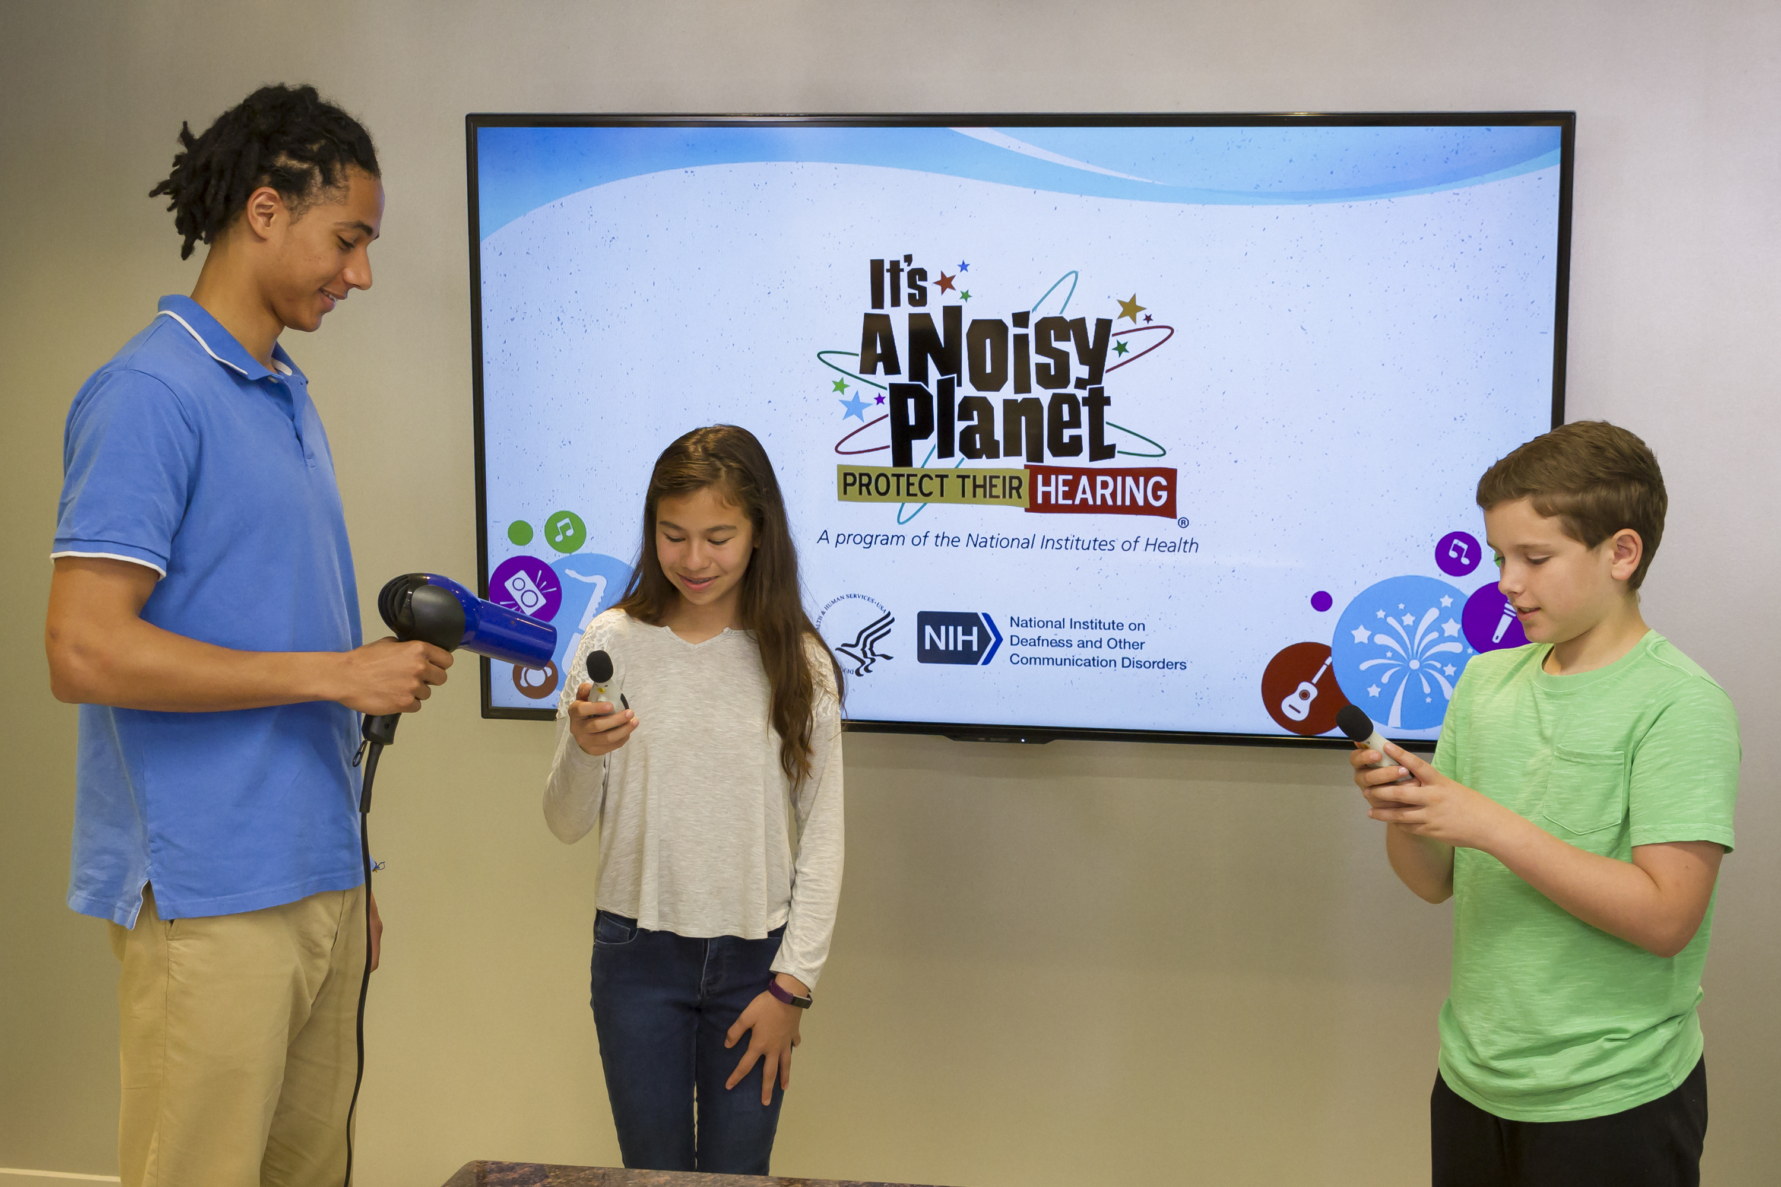
Household Appliance Experiment
Notes:
[Noisy Planet Student Activity: Refer to the Blow Dryer Demonstration video as a guide. (https://www.noisyplanet.nidcd.nih.gov/educators/teacher-toolkit)]
Ask two kids to volunteer for this. One will run the blow dryer and another will stand next to it with the decibel level meter. One volunteer will read the meter when the appliance is on full blast and near the appliance. The second volunteer will stand about 15 feet away from the appliance when it is running full blast and will read the meter. Once all have their readings, the rest of the class will guess what the decibel readings were, and the students will divulge their numbers.
The take-home message: moving away from loud sounds does make a difference in protecting your hearing.
Note that we don’t want to imply that someone can get noise-induced hearing loss from a blender, hair dryer, or other common household appliance. The amount of time spent doing the activity and the distance from the appliance makes a difference. We just want to show that there are many noises in our environment, some of which—such as some blow dryers—are at the same levels of a rock concert, for example. Ask the students if they can imagine running a blow dryer directly into their ear for 2 hours straight (the length of a typical concert)?
The National Institute for Occupational Safety and Health (NIOSH), part of the Centers for Disease Control and Prevention (CDC), developed the NIOSH Sound Level Meter app for iOS devices to help promote better hearing health and prevention efforts. You can download the free app on iTunes.

Slide 19
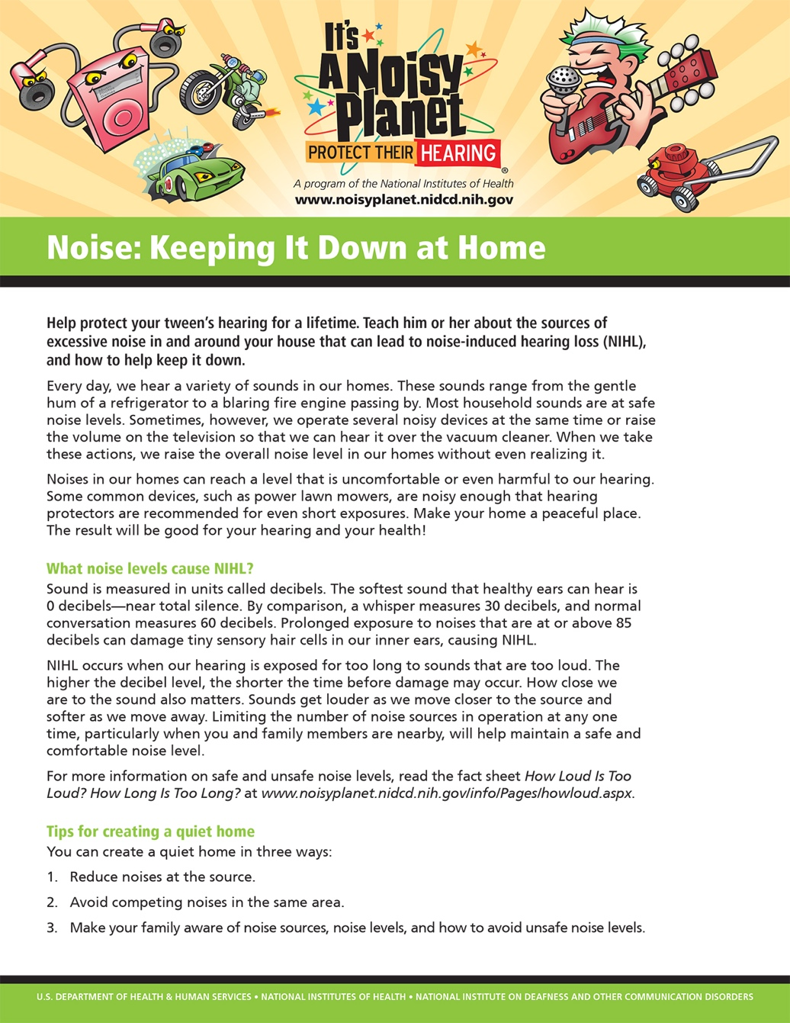

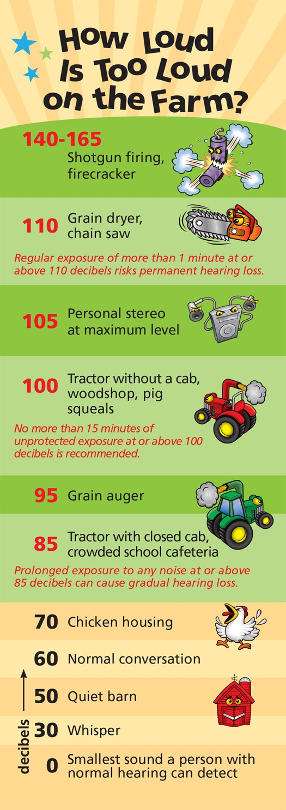

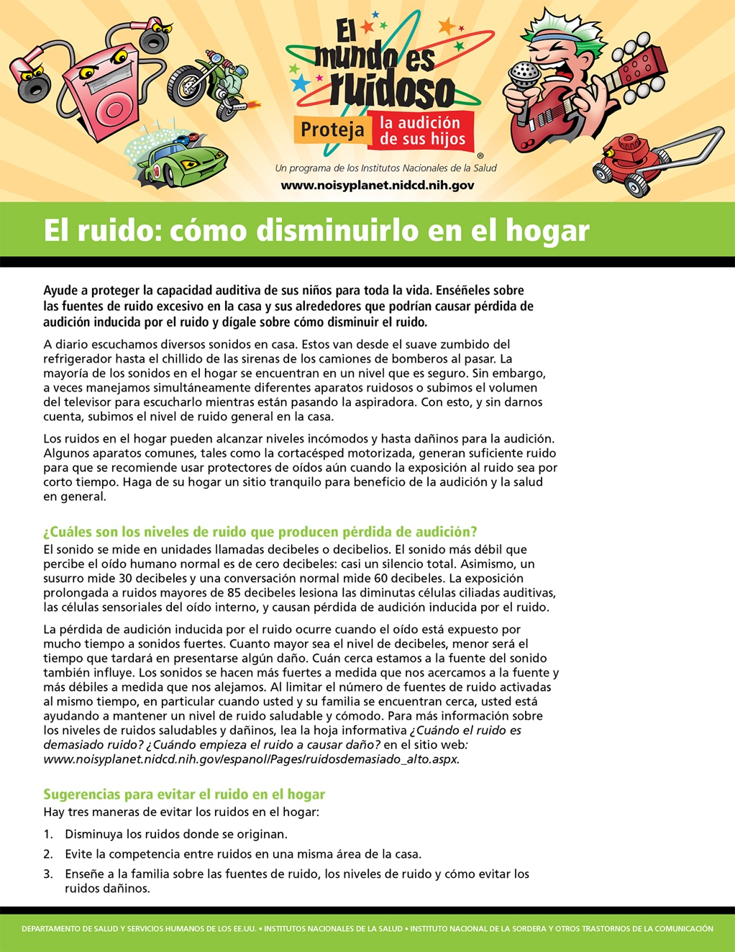
Educational Materials
Fact Sheets
Posters
Bookmarks
Notes:
Here are some examples of free educational materials that the NIDCD offers.

Slide 20
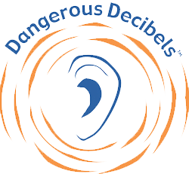
For more information, visit:
https://www.noisyplanet.nidcd.nih.gov
Presentation adapted from Dangerous Decibels, partner to the Noisy Planet campaign
Notes:
Visit the Noisy Planet website to find more information about noise-induced hearing loss, games, and other fun activities.

